Slide 1
What IS Node
How node works –
BLOCKING VS NON-BLOCKING
EVENT QUEUE
WHY USE NODE
agenda
INSTALL NODE – Demo “Hello world” program
REST API and standards
Mongo DB basics
INSTALL and connect to mongo-db
SQL VS NOSQL

Slide 2
Pre requisites

Slide 3
Self placed courses Learning target to enter in to MEAN stack course
Introduction to MongoDB
https://accenture.percipio.com/channels/150c1001-0e64-11e7-92d8-37e13b311be2

Slide 4
Local system setup To complete prior to instructor led MEAN stack course starts
Download and install Visual Studio Code
https://code.visualstudio.com/
Download and install Node and NPM
https://docs.npmjs.com/downloading-and-installing-node-js-and-npm
Download MongoDB and install community version from below link
https://www.mongodb.com/download-center/community

Slide 5
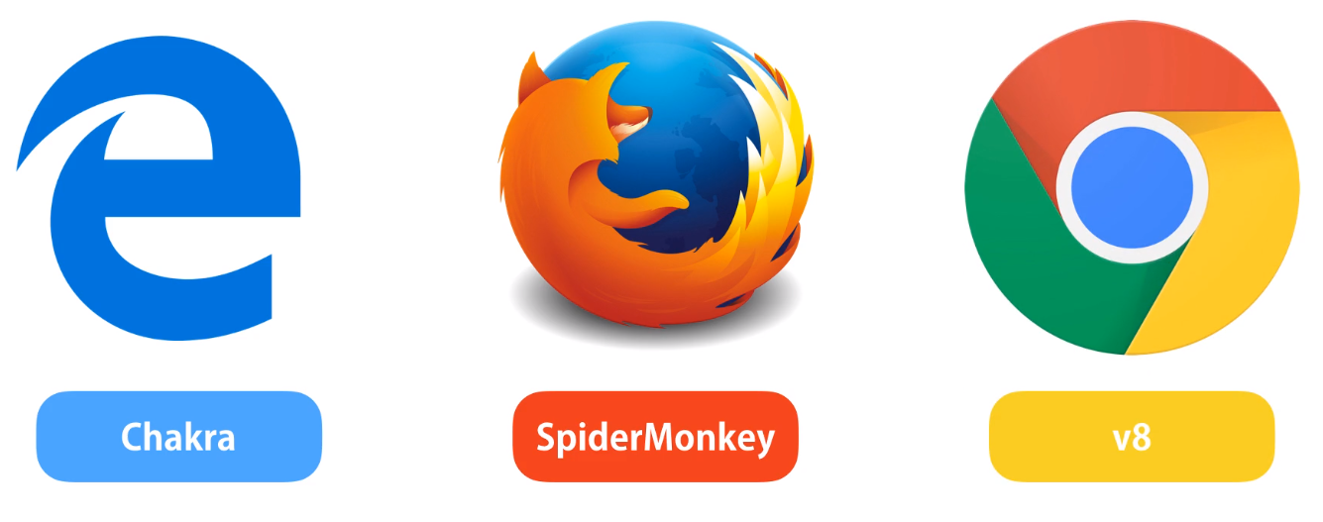
What is node ? – Evolution of node
Browser runtime
Browser provides runtime for JavaScript code
Each browser has different JavaScript engines
Internet explorer – Chakra
Chrome – V8
Firefox - Spider Monkey
Up to 2009 JavaScript could execute only inside a browser
Ryan Dhal – Creator of node thought of executing JavaScript outside outside browser
V8 is an open source JavaScript Engine written in C++ and used in google chrome browser
V8 engine was taken out of chrome and embedded in a C++ program . This was called as NODE, a runtime environment for JavaScript outside browser
Nodejs Runs on V8 Engine , 40% JavaScript and 60% C++
JavaScript
Engine
Java Script Code
Machine Code
Chrome
Node.exe
V8 Engine
V8 Engine

Slide 6
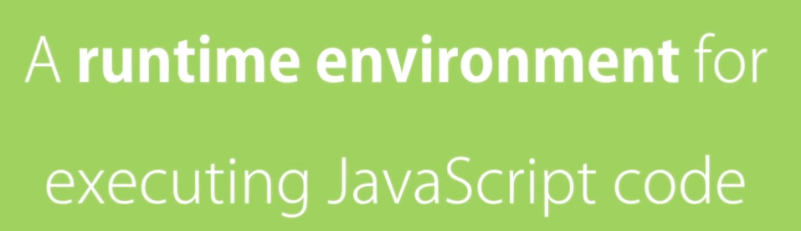
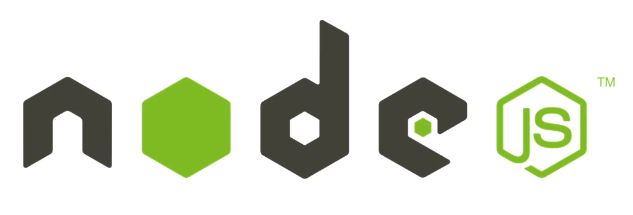


What is node?
Web App
Back end
Services
Mobile App
Why/WHEN to use node
Great for prototyping and agile development
Good for creating streaming based realtime services, web chat applications, static file servers Etc.
Superfast and highly scalable
JavaScript everywhere- Client side & Server Side
Large ecosystem of open-source libs
WHEN NOT to use node
Data Calculations
Processor Intensive
Blocking Operations
Notes:
Node goal is to provide an easy way to build scalable network programs like APIs

Slide 7
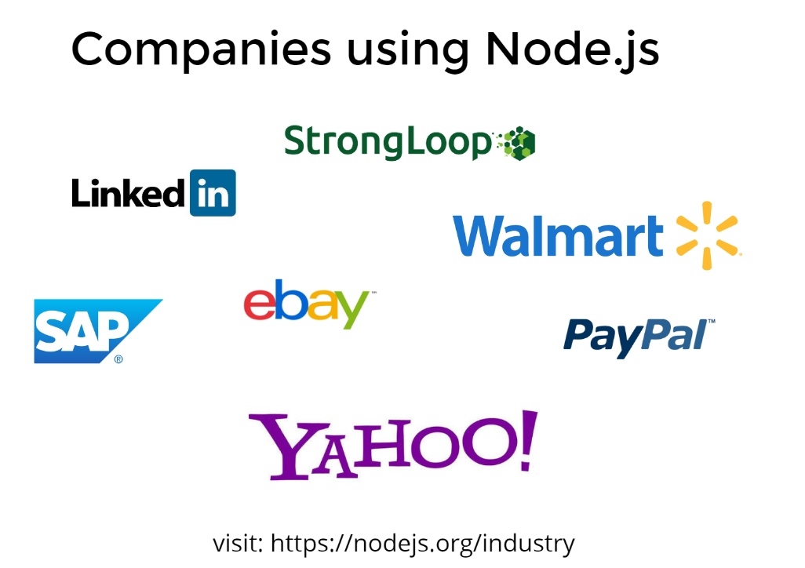

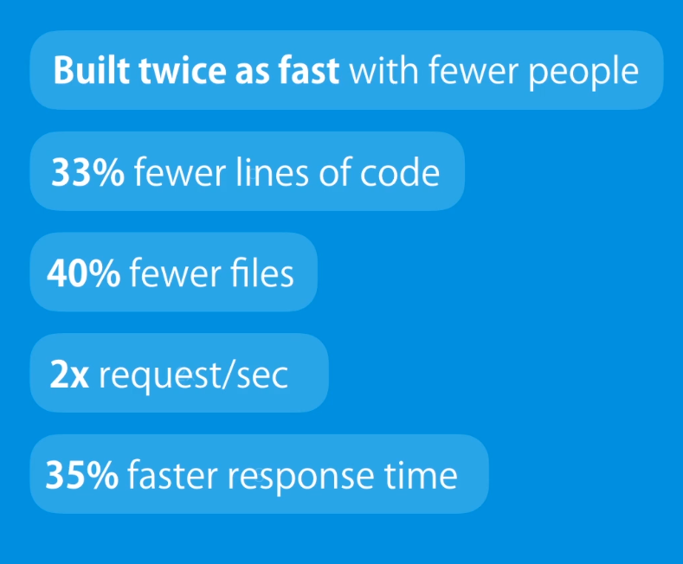
Companies using node?
EXAMPLE : FACT CHECK

Slide 8
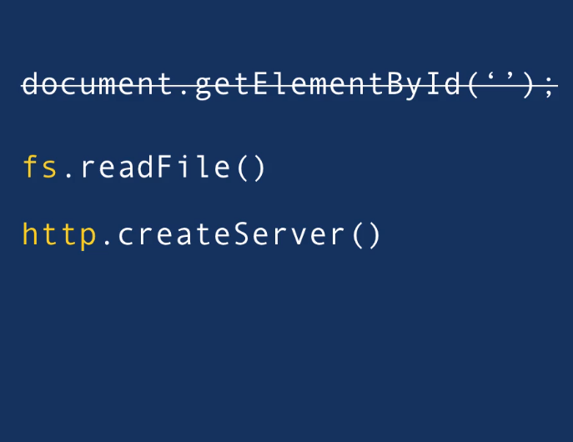
features of node
features of node
Similar to browser, Node is a runtime time environment for JavaScript code outside browser
Node will not have any objects to deal with html like document.getElementById
Node will have additional capability to
Talk to file system or n/w
Listen for a request at a port
Talk to other http services
Don’t compare node to other programming language like C# or Java
Node is not a programming language , rather it is a runtime environment

Slide 9
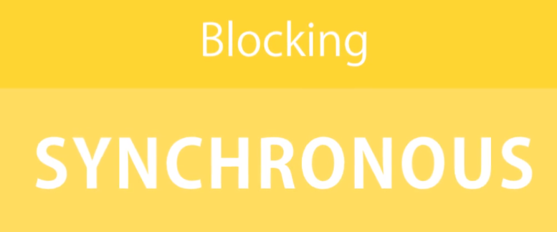
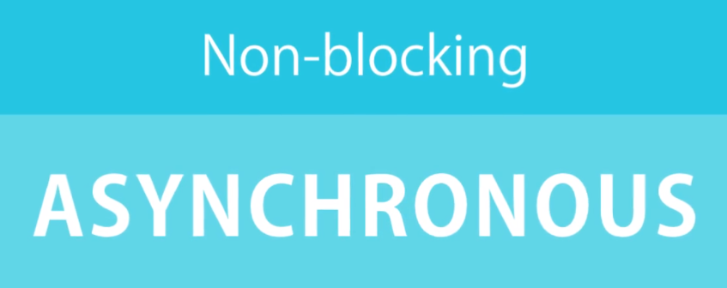
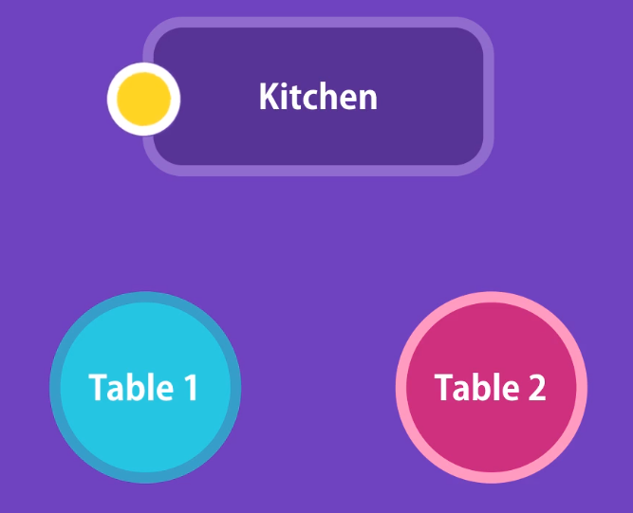
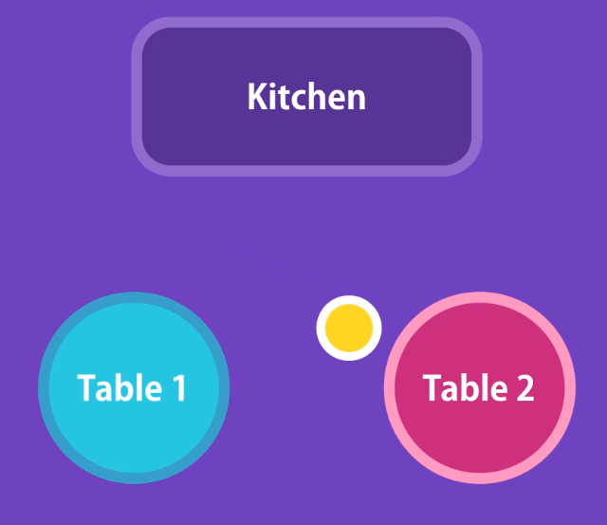
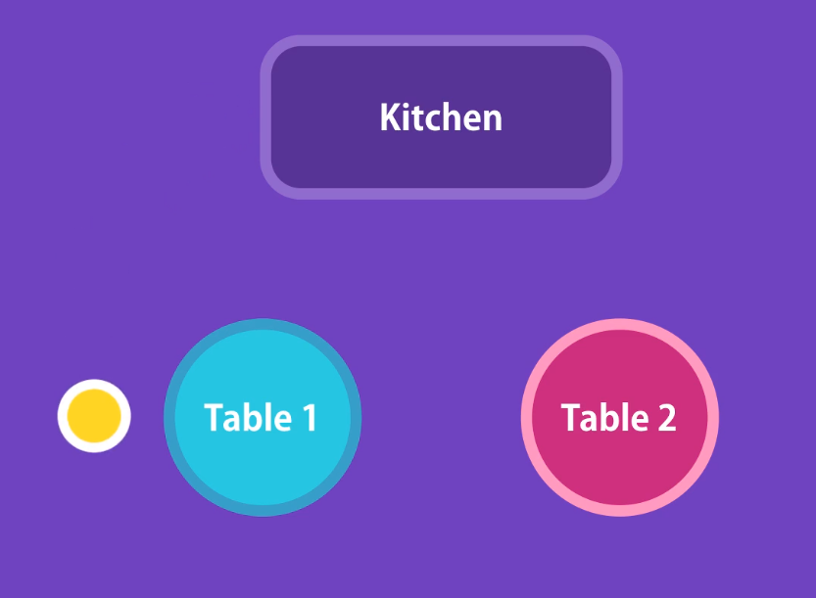
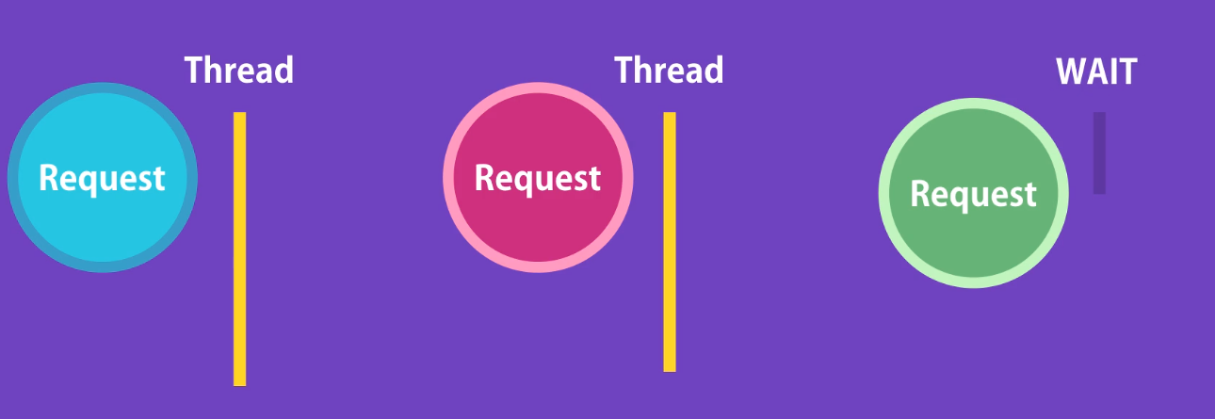
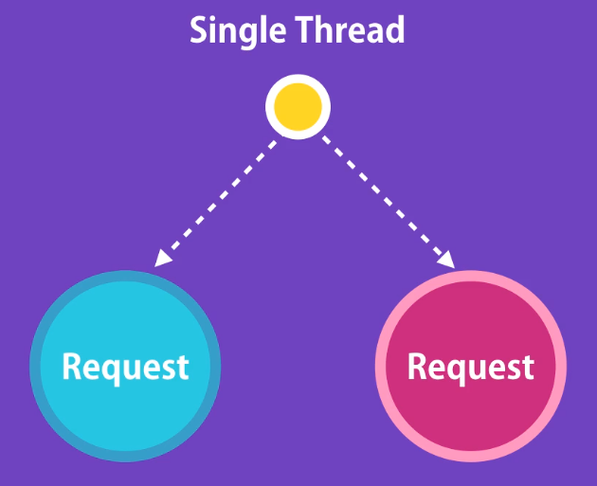
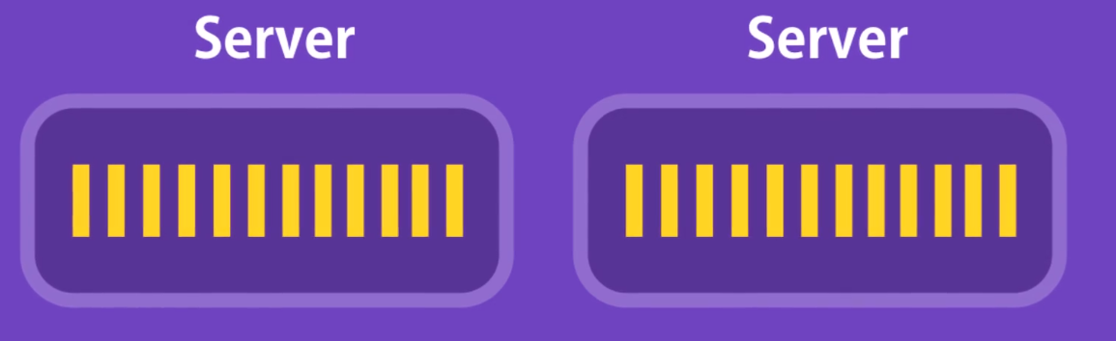
HOW NODE works
Synchronous vs asynchronous
SCENARIO
Notes:
Explain Synchronous and Asynchronous process without referring to nodejs

Slide 10
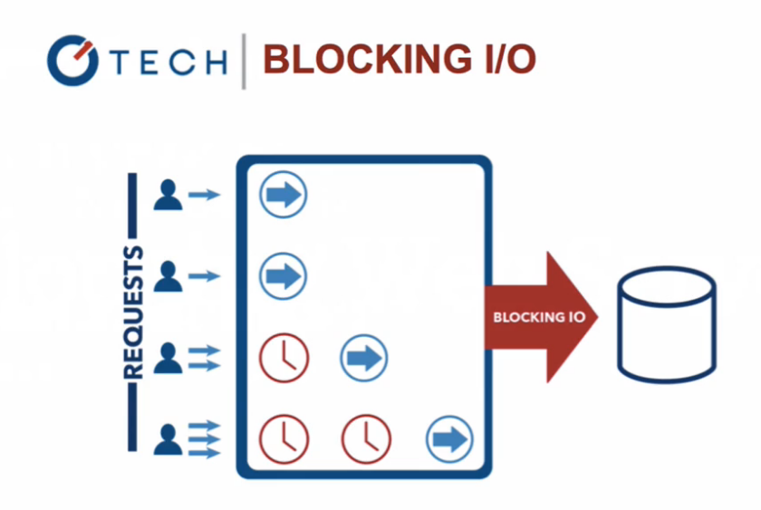

HOW NODE works – BLOCKING VS NON BLOCKING
Notes:
Explain Synchronous and Asynchronous process without referring to nodejs

Slide 11

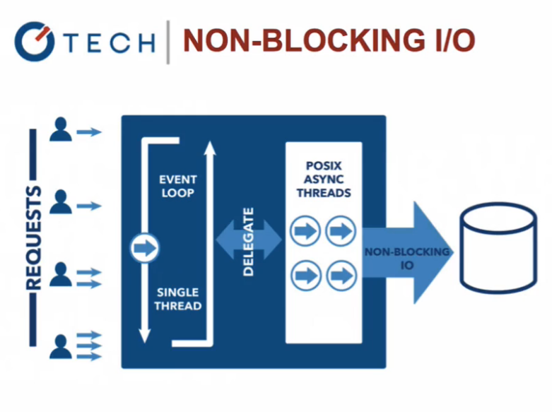
HOW NODE works – BLOCKING VS NON BLOCKING
Notes:
Explain Synchronous and Asynchronous process without referring to nodejs

Slide 12
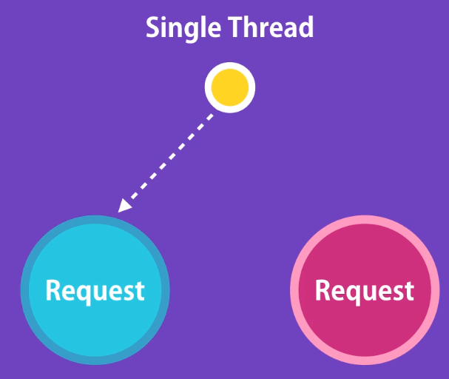
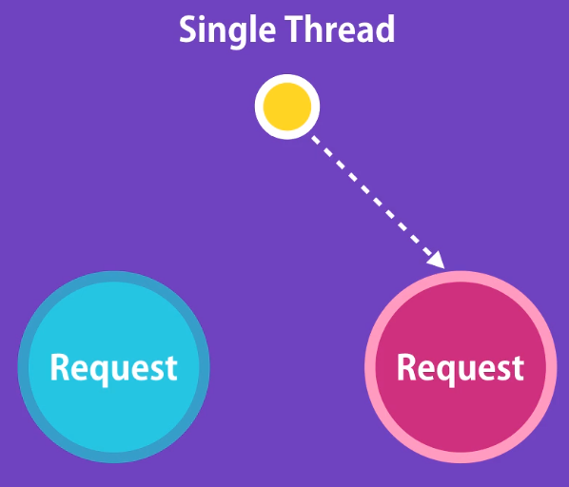
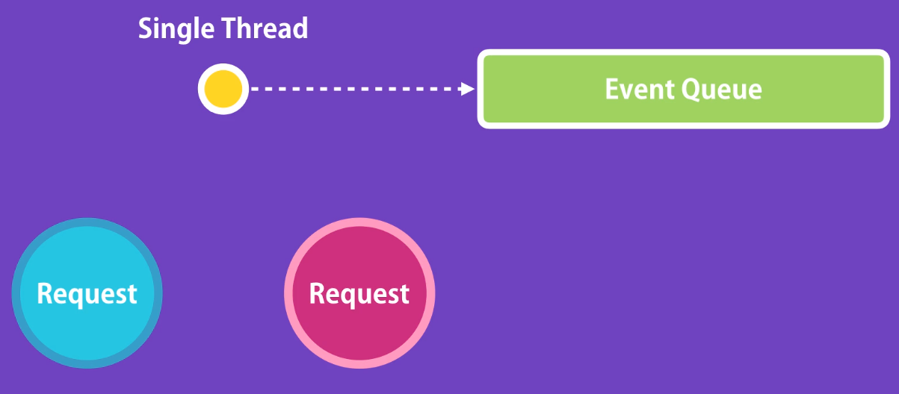
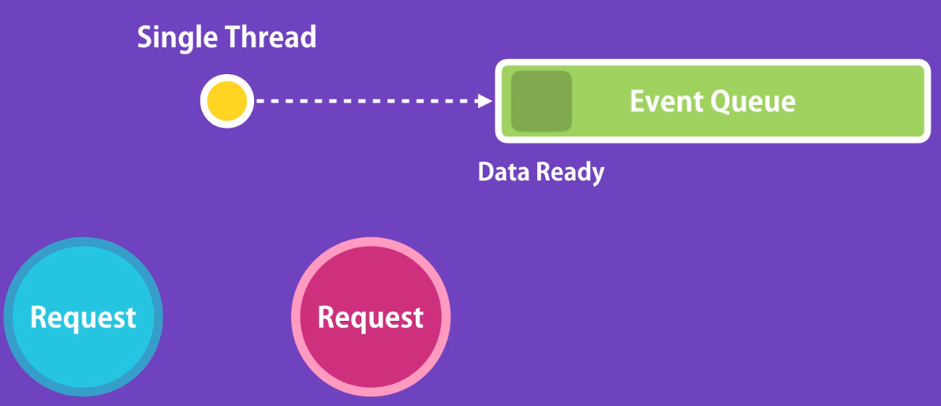
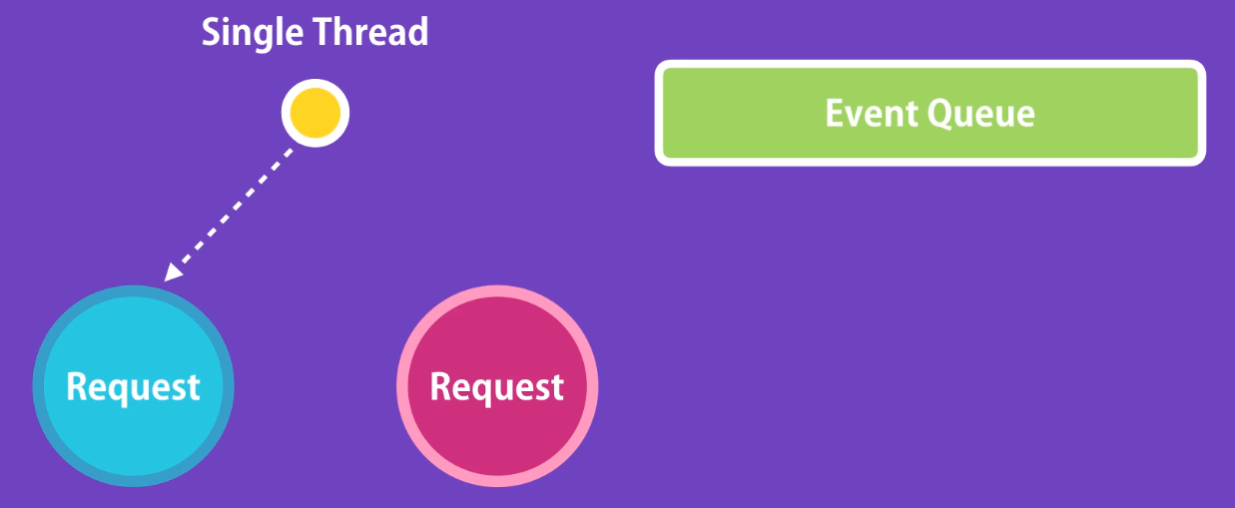
HOW NODE works – Event queue

Slide 13
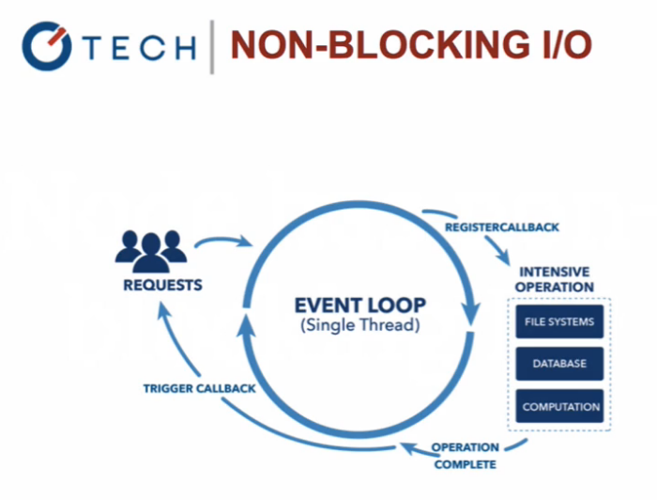
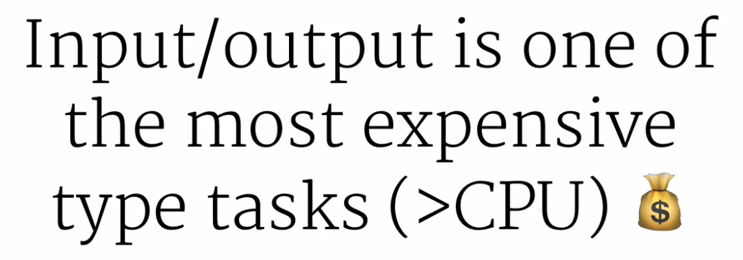
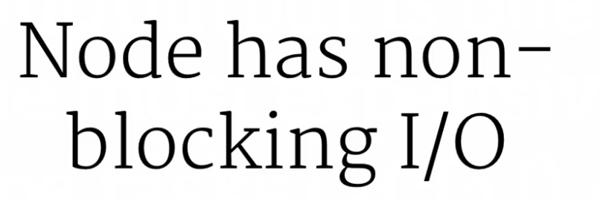
WHY USE NODE ?
So why use node?
So we use node because it is single threaded, very efficient and very fast and optimized to run javascript code

Slide 14
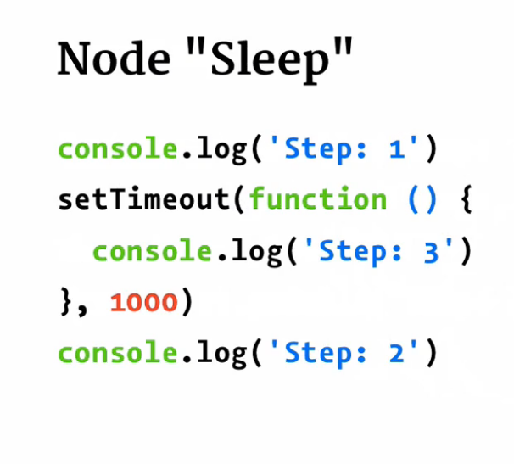
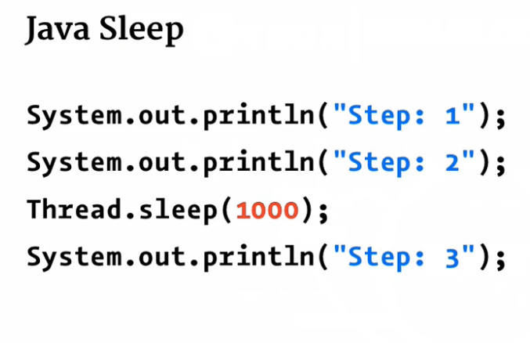
WHY USE NODE ? Continued…( Example)

Slide 15
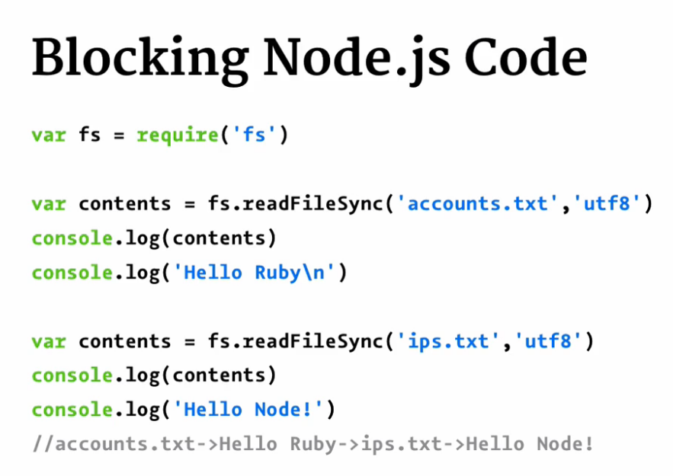
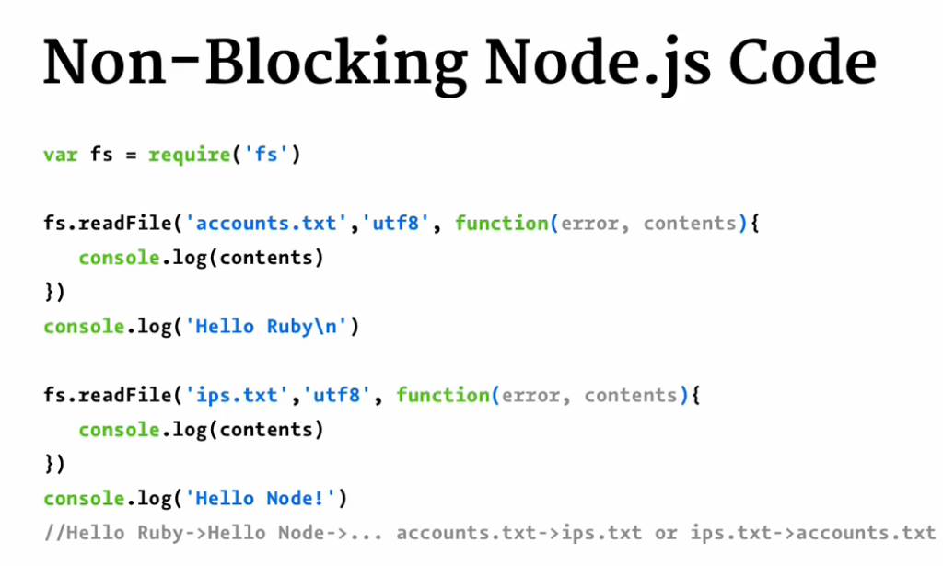
WHY USE NODE ? Continued…( Example)

Slide 16
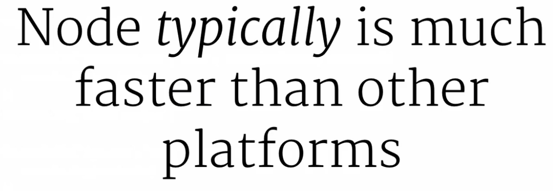
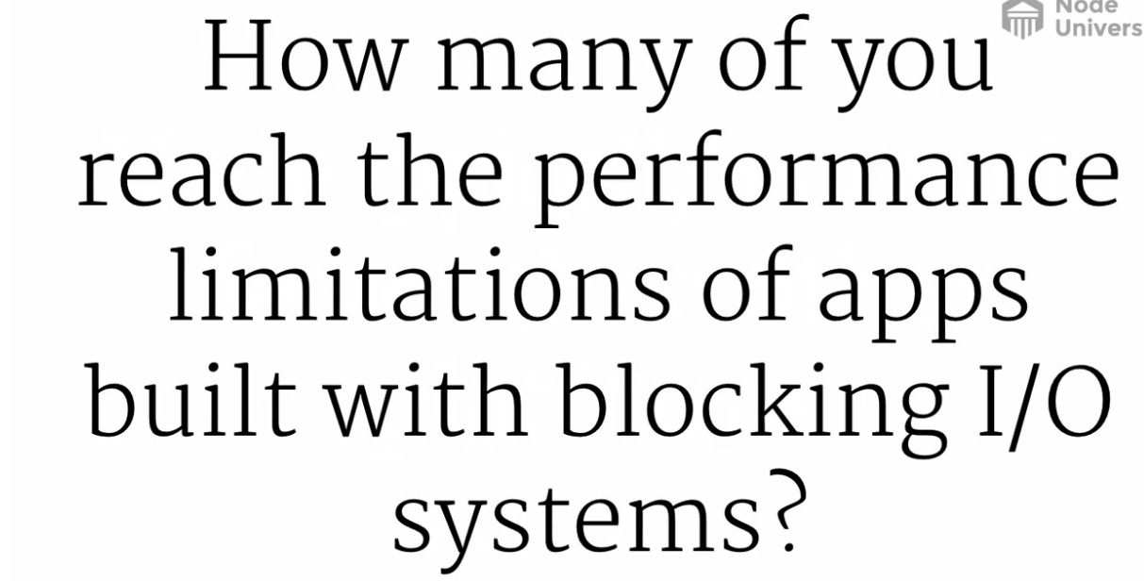

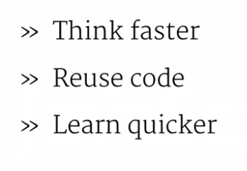
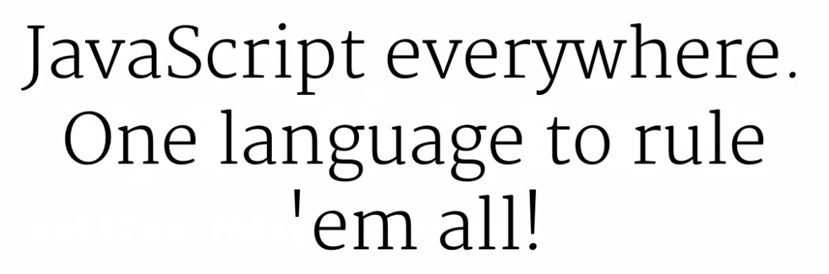
WHY USE NODE ? Continued…( Example)

Slide 17
Useful Links
Event Loop architecture reference
https://www.youtube.com/watch?v=8aGhZQkoFbQ
https://blog.carbonfive.com/2013/10/27/the-javascript-event-loop-explained/
Why prefer nodejs over .NET or java
https://www.infoworld.com/article/2975233/javascript/why-node-js-beats-java-net-for-web-mobile-iot-apps.html
http://www.dotnettricks.com/learn/nodejs/advantages-and-limitations-of-nodejs
Node University
https://node.university/courses/you-dont-know-node/lectures/1590275
Javascript eventloop visualized
https://dev.to/lydiahallie/javascript-visualized-event-loop-3dif

Slide 18
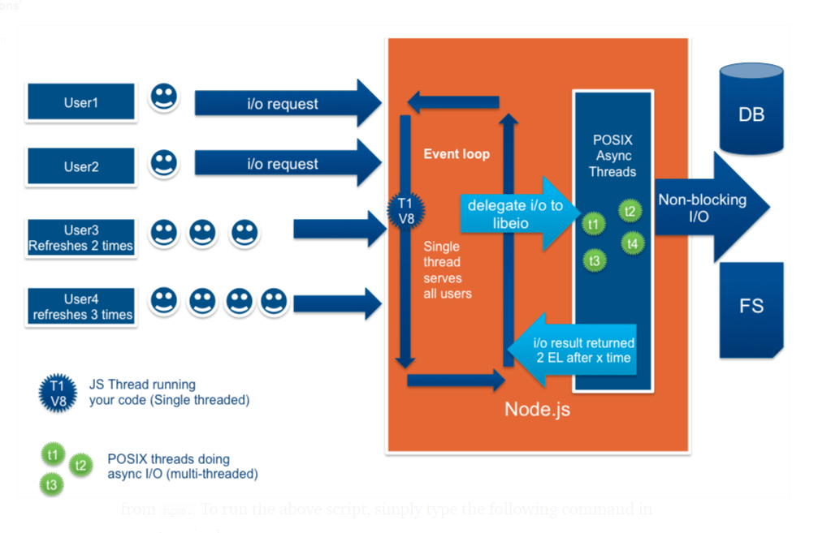
NODE architecture - in perspective
Architecture features
Most of the server-side languages, like PHP, ASP.NET, Ruby, JAVA servers, follow multi-threaded architecture. That means, every request by the client results in the instantiation of a new thread or even a process.
However, in Node.js, all request are handled in a single thread with shared resources. Then how does Node.js handle concurrent traffic or requests? It follows “Single Threaded Event Loop Model” architecture that runs on top of single V8 engine instance.
Node.js is event-driven that implements background workers to achieve non-blocking asynchronous behavior. We called it the Observer Pattern. Node thread keeps an event loop and whenever a task gets completed, it fires the corresponding event which signals the event-listener function to execute as illustrated below.
Event Loop architecture reference
https://www.youtube.com/watch?v=8aGhZQkoFbQ
https://blog.carbonfive.com/2013/10/27/the-javascript-event-loop-explained/
Why prefer nodejs over .NET or java
https://www.infoworld.com/article/2975233/javascript/why-node-js-beats-java-net-for-web-mobile-iot-apps.html
http://www.dotnettricks.com/learn/nodejs/advantages-and-limitations-of-nodejs

Slide 19
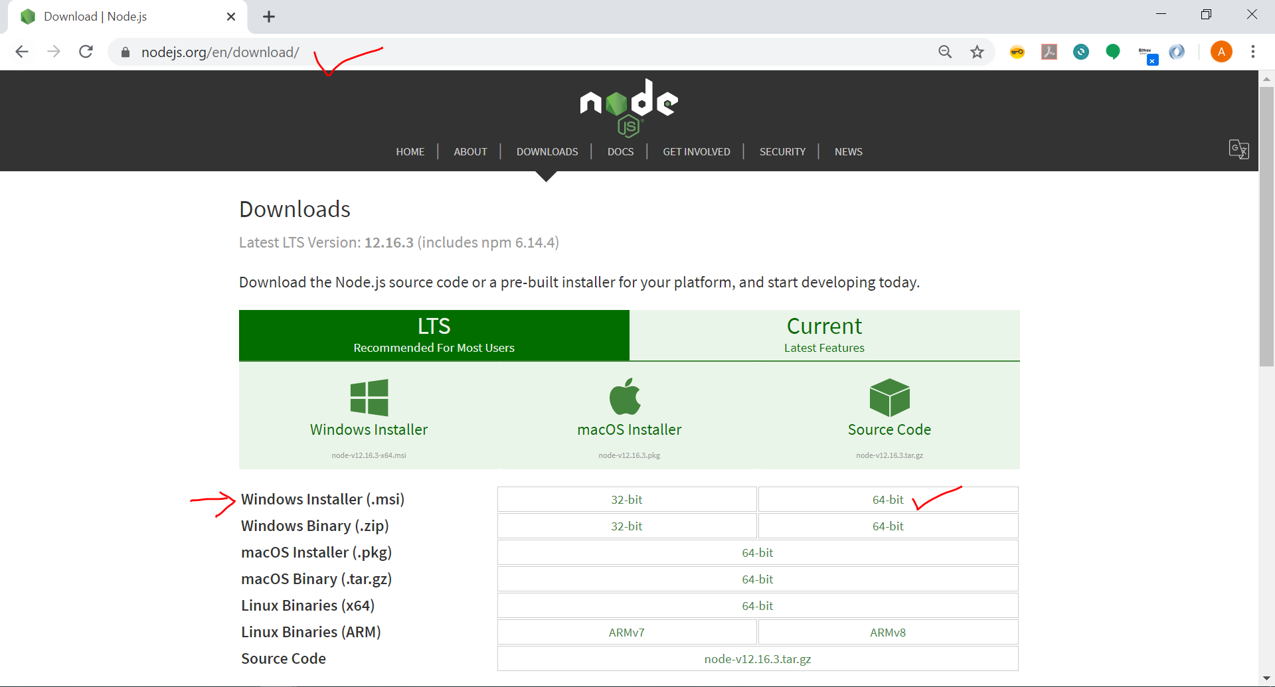
INSTALLING NODE – LaB Manual
Install node from https://nodejs.org/en/download/

Slide 20
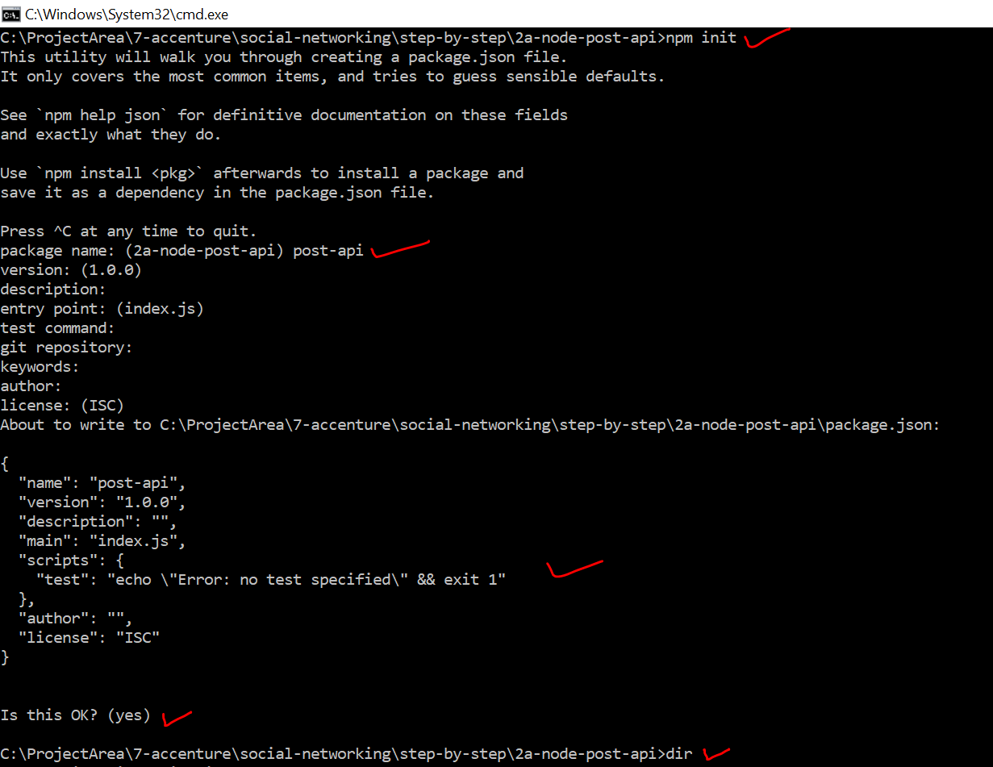
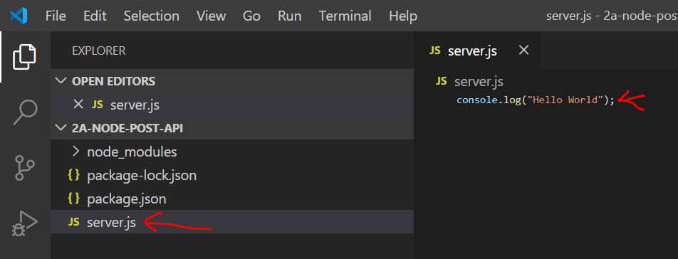
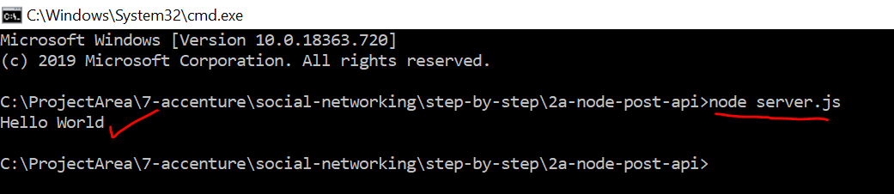
start a new Project –DEMO – LaB Manual
STEP3 – As node can execute a JavaScript code , lets write a simple hello world JavaScript program and execute inside node runtime
STEP2 –”npm init” from any project folder
STEP4 – Run command “node server.js”

Slide 21
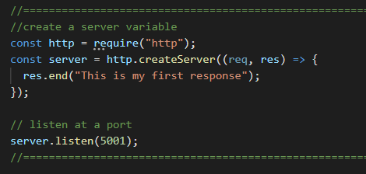
Convert the api project to server – LaB Manual

Slide 22



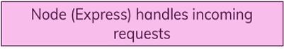

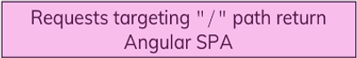
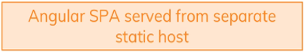
Connecting Node & Angular –with an example

Slide 23
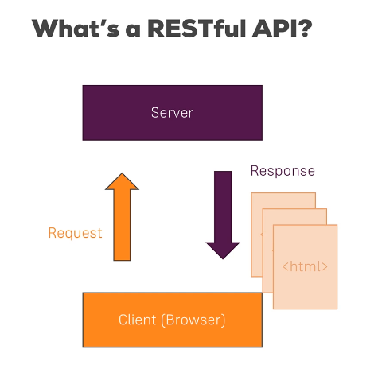
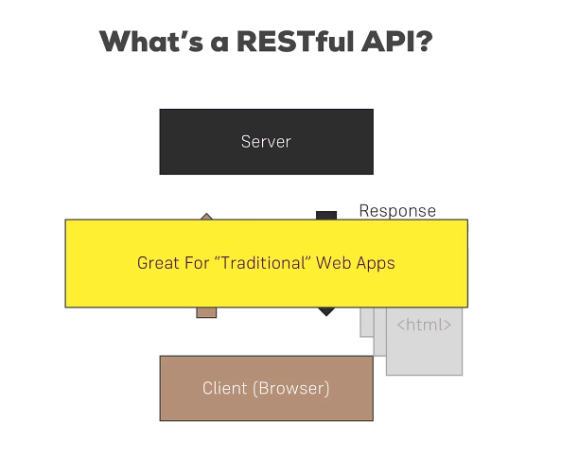
CLIENT–server communication and evolution of REST Standard

Slide 24


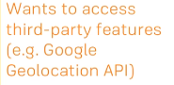




CLIENT–server communication and evolution of REST Standard

Slide 25

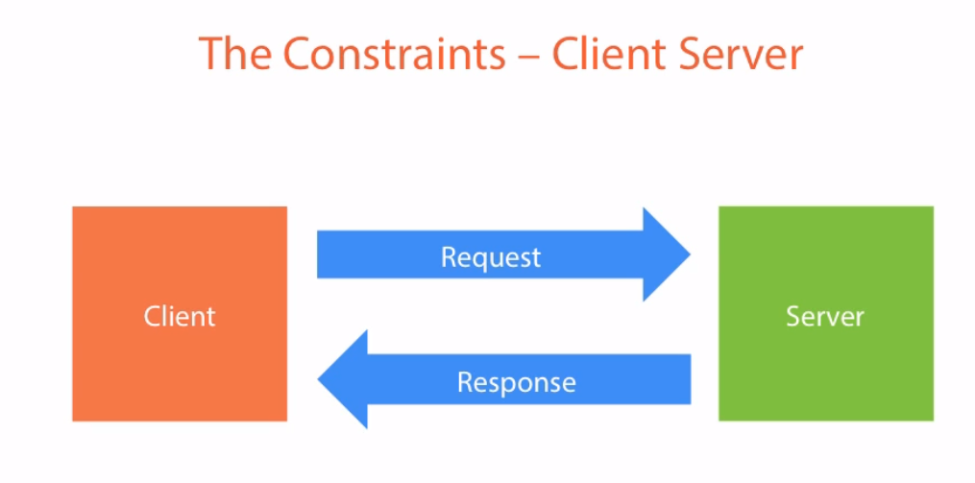
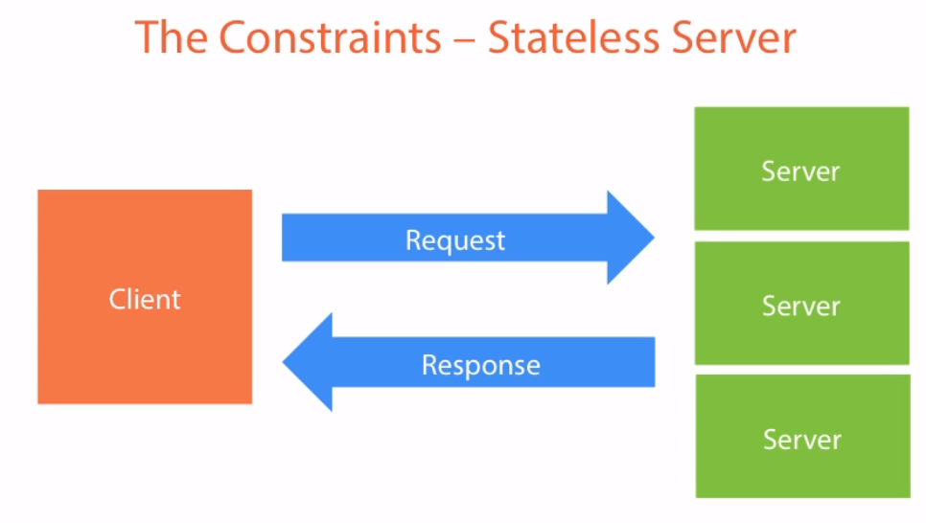
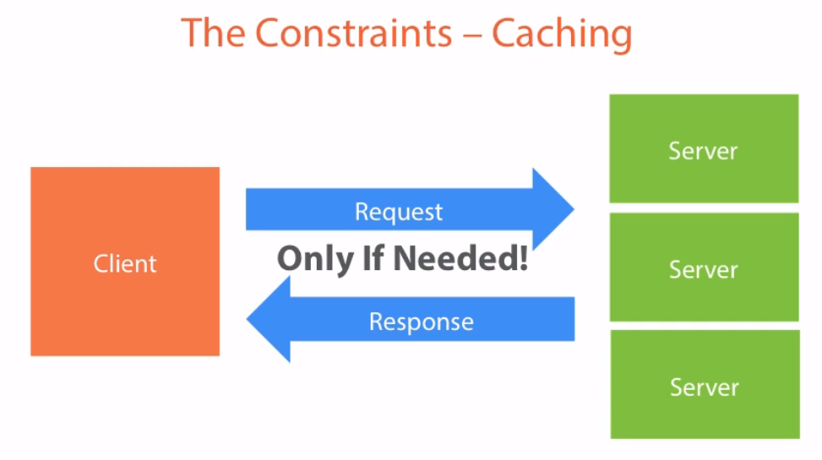
What is REST anyway?
REST…
REST = Representational State Transfer
Not a new technology
Architectural Style of Client-Server
Notes:
ReST respresents a series of constraints whenever a client talks to server , series of rules in the server for client to use to service
Constraint
Client sends request and server sends response
As load increases we add more servers , now we get into situation where server 1 may contain some info of client which doesn’t get transferred to server 2. Don’t get into this situation. Each request should have the all info to process the request. Example..
Caching – send the data to client with the info that how long the data is valid for and not to come back to server over and over again

Slide 26
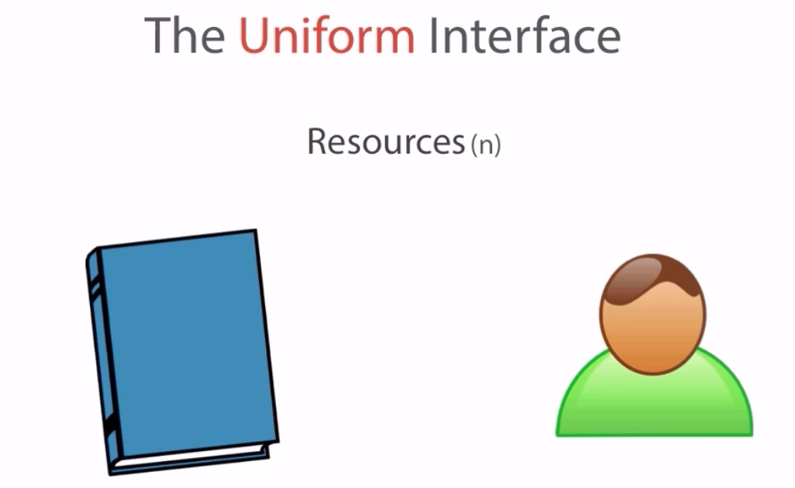


REST - Constraint.. – The Uniform Interface NOUNS and VERBS
REST…
REST = Representational State Transfer
Not a new technology
Architectural Style of Client-Server
Generic interface
Scalability of component Interface
Reduce Latency
Encapsulate Legacy System
https://restfulapi.net/

Slide 27
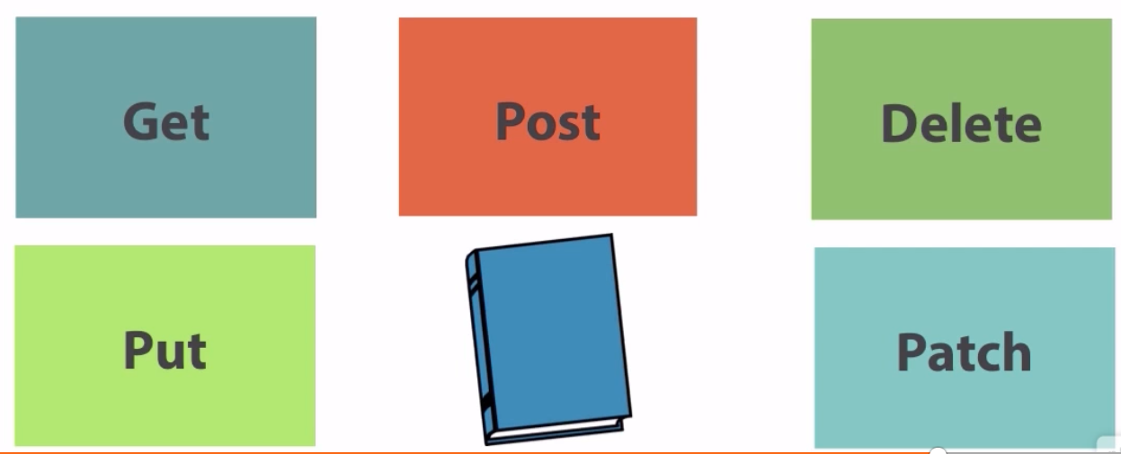
REST - Constraint.. – The Uniform Interface NOUNS ands VERBS
Best practices for defining REST APIs
http://www.vinaysahni.com/best-practices-for-a-pragmatic-restful-api

Slide 28
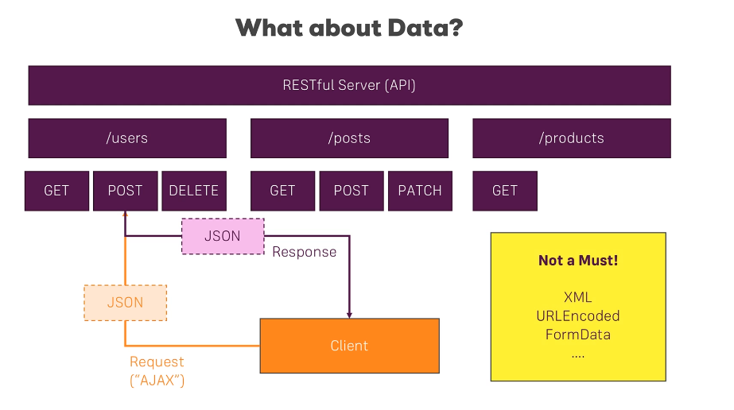
REST Standard - for uri, operation and Data
Notes:
From https://restfulapi.net/

Slide 29

https://restfulapi.net/
Notes:
From https://restfulapi.net/
https://medium.com/hashmapinc/rest-good-practices-for-api-design-881439796dc9

Slide 30




https://medium.com/hashmapinc/rest-good-practices-for-api-design-881439796dc9
Notes:
From https://restfulapi.net/
https://medium.com/hashmapinc/rest-good-practices-for-api-design-881439796dc9

Slide 31



Adding node backend inside angular project- Demo
Notes:
Reference to express
Setup a port
App.get to root , if someone goes to root return them a hello world message
App.listen with a message

Slide 32

Adding Express
Notes:
Reference to express
Setup a port
App.get to root , if someone goes to root return them a hello world message
App.listen with a message

Slide 33

Express and other similar libraries
Notes:
Reference to express
Setup a port
App.get to root , if someone goes to root return them a hello world message
App.listen with a message

Slide 34




Adding Express - Demo
Notes:
Reference to express
Setup a port
App.get to root , if someone goes to root return them a hello world message
App.listen with a message

Slide 35
DEMO REMAINING NODE – Follow the lab manual
Adding Express Framework with middleware
Improving Server.js code
Fetching Initial Posts
Using Angular HTTP Client
Understanding CORS
Adding POST Backend Point
Adding Angular
Notes:
Reference to express
Setup a port
App.get to root , if someone goes to root return them a hello world message
App.listen with a message

Slide 36

CORS – Cross Origin Resource Sharing
Reference - https://www.youtube.com/watch?v=YAvnt-32W8M
It is a functionality of the browser
Notes:
Reference to express
Setup a port
App.get to root , if someone goes to root return them a hello world message
App.listen with a message

Slide 37

CORS – Cross Origin Resource Sharing
Reference - https://www.youtube.com/watch?v=baQh1X3LN5s
Notes:
Reference to express
Setup a port
App.get to root , if someone goes to root return them a hello world message
App.listen with a message

Slide 38

CORS – Cross Origin Resource Sharing
Notes:
Reference to express
Setup a port
App.get to root , if someone goes to root return them a hello world message
App.listen with a message

Slide 39






WHAT is mongo db?

Slide 40

MongoDB - Overview
MongoDB is an open-source cross-platform document-oriented database program.
Classified as a NoSQL database program
MongoDB uses JSON-like documents with schemas.
MongoDB is developed by MongoDB Inc., and is published under a combination of the GNU Affero General Public License and the Apache License.
Provides
High Performance
High Availability
Easy Scalability

Slide 41

RDBMS VS MongoDB

Slide 42














NO SQL VS SQL

Slide 43
Reasons for using NOSQL
To prevent the database from becoming a system-wide bottleneck, especially in high volume environments, NoSQL databases perform in a way that relational databases cannot.
The following features are driving the popularity of NoSQL databases like MongoDB, CouchDB, Cassandra, and HBase:
1. Storing large volumes of data without structure. A NoSQL database doesn’t limit storable data types. Plus, you can add new types as business needs change.
2. Using cloud computing and storage. Cloud-based storage is a great solution, but it requires data to be easily spread across multiple servers for scaling. Using affordable hardware on-site for testing and then for production in the cloud is what NoSQL databases are designed for.
3. Rapid development. If you are developing using modern agile methodologies, a relational database will slow you down. A NoSQL database doesn’t require the level of preparation typically needed for relational databases.

Slide 44

SQL VS NOSQL - Scalability
One of the main issues with SQL is ease of scalability. SQL is designed to scale up. What we mean by “scaling up” or scaling vertically is adding extra hardware, RAM, processing power, etc. in order to increase capacity.
Here’s the key difference when comparing SQL vs. NoSQL scalability: NoSQL engines are designed to scale out and leverage cloud computing.
Reference : https://www.integrant.com/when-to-use-sql-vs-nosql/

Slide 45

SQL VS NOSQL

Slide 46








Can we connect angular App directly to mongodb ?

Slide 47

Wire-up Mongo DB ( 2 OPTIONS LOCALLY INSATLL or cLOUD)
STEP 1 : Download and install MongoDB - https://www.mongodb.com/download-center/community
STEP 2 : MongoDB requires a data directory to store all data. MongoDB’s default data directory path is the absolute path \data\db on the drive from which you start MongoDB. Create this folder by running the following command in a Command Prompt:
C: \md \data\db
STEP 3 : Start MongoDB by running command
"C:\Program Files\MongoDB\Server\3.6\bin\mongod.exe"
STEP 4 : To connect to MongoDB through the ~bin.mongo.exe shell, open another Command Prompt.
"C:\Program Files\MongoDB\Server\3.6\bin\mongo.exe"

Slide 48
Appendix

